Slide 1

Slides for Chapter 4:
Interprocess Communication
From Coulouris, Dollimore, Kindberg and Blair
Distributed Systems:
Concepts and Design
Edition 5, © Addison-Wesley 2012

Slide 2
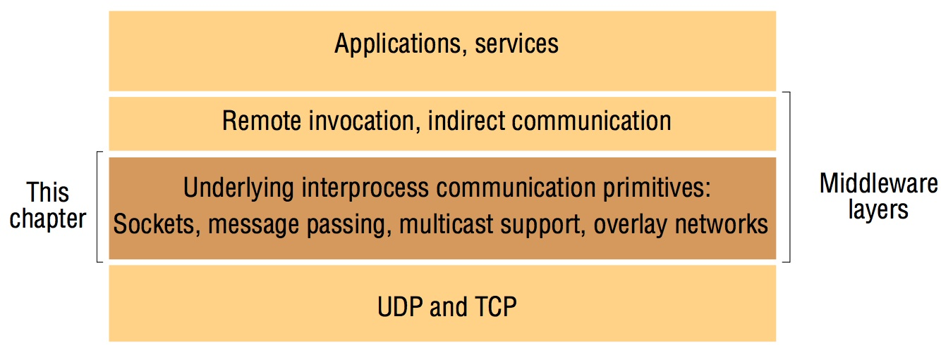
Figure 4.1
Middleware layers
Instructor’s Guide for Coulouris, Dollimore, Kindberg and Blair, Distributed Systems: Concepts and Design Edn. 5
© Pearson Education 2012

Slide 3
Figure 4.2
Sockets and ports
any port
agreed port
socket
socket
message
client
server
other ports
Internet address = 138.37.94.248
Internet address = 138.37.88.249
Instructor’s Guide for Coulouris, Dollimore, Kindberg and Blair, Distributed Systems: Concepts and Design Edn. 5
© Pearson Education 2012

Slide 4
Figure 4.3
UDP client sends a message to the server and gets a reply
import java.net.*;
import java.io.*;
public class UDPClient{
public static void main(String args[]){
// args give message contents and server hostname
DatagramSocket aSocket = null;
try {
aSocket = new DatagramSocket();
byte [] m = args[0].getBytes();
InetAddress aHost = InetAddress.getByName(args[1]);
int serverPort = 6789;
DatagramPacket request = new DatagramPacket(m, m.length(), aHost, serverPort);
aSocket.send(request);
byte[] buffer = new byte[1000];
DatagramPacket reply = new DatagramPacket(buffer, buffer.length);
aSocket.receive(reply);
System.out.println("Reply: " + new String(reply.getData()));
}catch (SocketException e){System.out.println("Socket: " + e.getMessage());
}catch (IOException e){System.out.println("IO: " + e.getMessage());}
}finally {if(aSocket != null) aSocket.close();}
}
}
Instructor’s Guide for Coulouris, Dollimore, Kindberg and Blair, Distributed Systems: Concepts and Design Edn. 5
© Pearson Education 2012

Slide 5
Figure 4.4
UDP server repeatedly receives a request and sends it back to the client
import java.net.*;
import java.io.*;
public class UDPServer{
public static void main(String args[]){
DatagramSocket aSocket = null;
try{
aSocket = new DatagramSocket(6789);
byte[] buffer = new byte[1000];
while(true){
DatagramPacket request = new DatagramPacket(buffer, buffer.length);
aSocket.receive(request);
DatagramPacket reply = new DatagramPacket(request.getData(),
request.getLength(), request.getAddress(), request.getPort());
aSocket.send(reply);
}
}catch (SocketException e){System.out.println("Socket: " + e.getMessage());
}catch (IOException e) {System.out.println("IO: " + e.getMessage());}
}finally {if(aSocket != null) aSocket.close();}
}
}
Instructor’s Guide for Coulouris, Dollimore, Kindberg and Blair, Distributed Systems: Concepts and Design Edn. 5
© Pearson Education 2012

Slide 6
Figure 4.5
TCP client makes connection to server, sends request and receives reply
import java.net.*;
import java.io.*;
public class TCPClient {
public static void main (String args[]) {
// arguments supply message and hostname of destination
Socket s = null;
try{
int serverPort = 7896;
s = new Socket(args[1], serverPort);
DataInputStream in = new DataInputStream( s.getInputStream());
DataOutputStream out =
new DataOutputStream( s.getOutputStream());
out.writeUTF(args[0]); // UTF is a string encoding see Sn 4.3
String data = in.readUTF();
System.out.println("Received: "+ data) ;
}catch (UnknownHostException e){
System.out.println("Sock:"+e.getMessage());
}catch (EOFException e){System.out.println("EOF:"+e.getMessage());
}catch (IOException e){System.out.println("IO:"+e.getMessage());}
}finally {if(s!=null) try {s.close();}catch (IOException e){System.out.println("close:"+e.getMessage());}}
}
}
Instructor’s Guide for Coulouris, Dollimore, Kindberg and Blair, Distributed Systems: Concepts and Design Edn. 5
© Pearson Education 2012

Slide 7
Figure 4.6
TCP server makes a connection for each client and then echoes the client’s request
import java.net.*;
import java.io.*;
public class TCPServer {
public static void main (String args[]) {
try{
int serverPort = 7896;
ServerSocket listenSocket = new ServerSocket(serverPort);
while(true) {
Socket clientSocket = listenSocket.accept();
Connection c = new Connection(clientSocket);
}
} catch(IOException e) {System.out.println("Listen :"+e.getMessage());}
}
}
// this figure continues on the next slide
Instructor’s Guide for Coulouris, Dollimore, Kindberg and Blair, Distributed Systems: Concepts and Design Edn. 5
© Pearson Education 2012

Slide 8
Figure 4.6 continued
class Connection extends Thread {
DataInputStream in;
DataOutputStream out;
Socket clientSocket;
public Connection (Socket aClientSocket) {
try {
clientSocket = aClientSocket;
in = new DataInputStream( clientSocket.getInputStream());
out =new DataOutputStream( clientSocket.getOutputStream());
this.start();
} catch(IOException e) {System.out.println("Connection:"+e.getMessage());}
}
public void run(){
try { // an echo server
String data = in.readUTF();
out.writeUTF(data);
} catch(EOFException e) {System.out.println("EOF:"+e.getMessage());
} catch(IOException e) {System.out.println("IO:"+e.getMessage());}
} finally{ try {clientSocket.close();}catch (IOException e){/*close failed*/}}
}
}
Instructor’s Guide for Coulouris, Dollimore, Kindberg and Blair, Distributed Systems: Concepts and Design Edn. 5
© Pearson Education 2012

Slide 9
Figure 4.7
CORBA CDR for constructed types
T
y
p
e
Re
pr
e
s
e
n
ta
t
i
o
n
s
e
q
ue
n
ce
l
e
n
g
th
(
u
n
si
g
n
ed
l
o
n
g
)
fo
ll
ow
ed
b
y
el
e
m
e
nt
s
i
n
o
r
d
e
r
s
t
ri
n
g
l
e
n
g
th
(
u
n
si
g
n
ed
l
o
n
g
)
fo
ll
ow
ed
b
y
ch
a
ra
c
te
rs
i
n o
r
d
e
r
(
ca
n
al
so
ca
n
h
av
e
w
i
de
ch
a
ra
c
te
rs)
a
r
ra
y
a
rr
ay
e
le
m
e
n
t
s i
n
o
r
de
r (
n
o l
en
g
t
h s
p
e
ci
f
ie
d b
eca
us
e
i
t
is
f
i
x
e
d
)
s
t
ru
ct
i
n t
he
or
de
r o
f
de
c
la
r
at
i
o
n o
f
t
he
co
mp
o
n
e
n
t
s
e
n
u
m
e
r
a
t
e
d
u
n
s
i
g
n
e
d
l
o
n
g
(
t
h
e
v
a
l
ue
s a
re
s
pe
c
i
f
ie
d
b
y t
he
o
r
de
r d
ec
l
ar
e
d
)
u
ni
o
n
t
y
p
e
ta
g f
o
l
l
o
we
d b
y
t
h
e s
el
e
cte
d m
e
mb
er
Instructor’s Guide for Coulouris, Dollimore, Kindberg and Blair, Distributed Systems: Concepts and Design Edn. 5
© Pearson Education 2012

Slide 10
Figure 4.8
CORBA CDR message
index in
notes
sequence of bytes
4 bytes
on representation
0–3
5
length of string
4–7
"Smit"
‘Smith’
8–11
"h___"
12–15
6
length of string
16–19
"Lond"
‘London’
20-23
"on__"
24–27
1984
unsigned long
The flattened form represents a
Person
struct with value: {‘Smith’, ‘London’, 1984}
Instructor’s Guide for Coulouris, Dollimore, Kindberg and Blair, Distributed Systems: Concepts and Design Edn. 5
© Pearson Education 2012

Slide 11
Figure 4.9
Indication of Java serialized form
Serialized values
Explanation
Person
8-byte version number
h0
class name, version number
int year
java.lang.String
java.lang.String
number, type and name of
3
name:
place:
instance variables
1984
5 Smith
6 London
h1
values of instance variables
The true serialized form contains additional type markers; h0 and h1 are handles
Instructor’s Guide for Coulouris, Dollimore, Kindberg and Blair, Distributed Systems: Concepts and Design Edn. 5
© Pearson Education 2012

Slide 12
Figure 4.10 XML definition of the Person structure
<person id="123456789">
<name>Smith</name>
<place>London</place>
<year>1984</year>
<!-- a comment -->
</person >
Instructor’s Guide for Coulouris, Dollimore, Kindberg and Blair, Distributed Systems: Concepts and Design Edn. 5
© Pearson Education 2012

Slide 13
Figure 4.11 Illustration of the use of a namespace in the Person structure
<person pers:id="123456789" xmlns:pers = "http://www.cdk5.net/person">
<pers:name> Smith </pers:name>
<pers:place> London </pers:place >
<pers:year> 1984 </pers:year>
</person>
Instructor’s Guide for Coulouris, Dollimore, Kindberg and Blair, Distributed Systems: Concepts and Design Edn. 5
© Pearson Education 2012

Slide 14
Figure 4.12 An XML schema for the Person structure
<xsd:schema xmlns:xsd = URL of XML schema definitions >
<xsd:element name= "person" type ="personType" />
<xsd:complexType name="personType">
<xsd:sequence>
<xsd:element name = "name" type="xs:string"/>
<xsd:element name = "place" type="xs:string"/>
<xsd:element name = "year" type="xs:positiveInteger"/>
</xsd:sequence>
<xsd:attribute name= "id" type = "xs:positiveInteger"/>
</xsd:complexType>
</xsd:schema>
Instructor’s Guide for Coulouris, Dollimore, Kindberg and Blair, Distributed Systems: Concepts and Design Edn. 5
© Pearson Education 2012

Slide 15
Figure 4.13
Representation of a remote object reference
32 bits
32 bits
32 bits
32 bits
Internet address
port number
time
object number
interface of
remote object
Instructor’s Guide for Coulouris, Dollimore, Kindberg and Blair, Distributed Systems: Concepts and Design Edn. 5
© Pearson Education 2012

Slide 16
Figure 4.14
Multicast peer joins a group and sends and receives datagrams
import java.net.*;
import java.io.*;
public class MulticastPeer{
public static void main(String args[]){
// args give message contents & destination multicast group (e.g. "228.5.6.7")
MulticastSocket s =null;
try {
InetAddress group = InetAddress.getByName(args[1]);
s = new MulticastSocket(6789);
s.joinGroup(group);
byte [] m = args[0].getBytes();
DatagramPacket messageOut =
new DatagramPacket(m, m.length, group, 6789);
s.send(messageOut);
// this figure continued on the next slide
Instructor’s Guide for Coulouris, Dollimore, Kindberg and Blair, Distributed Systems: Concepts and Design Edn. 5
© Pearson Education 2012

Slide 17
Figure 4.14 continued
// get messages from others in group
byte[] buffer = new byte[1000];
for(int i=0; i< 3; i++) {
DatagramPacket messageIn =
new DatagramPacket(buffer, buffer.length);
s.receive(messageIn);
System.out.println("Received:" + new String(messageIn.getData()));
}
s.leaveGroup(group);
}catch (SocketException e){System.out.println("Socket: " + e.getMessage());
}catch (IOException e){System.out.println("IO: " + e.getMessage());}
}finally {if(s != null) s.close();}
}
}
Instructor’s Guide for Coulouris, Dollimore, Kindberg and Blair, Distributed Systems: Concepts and Design Edn. 5
© Pearson Education 2012

Slide 18
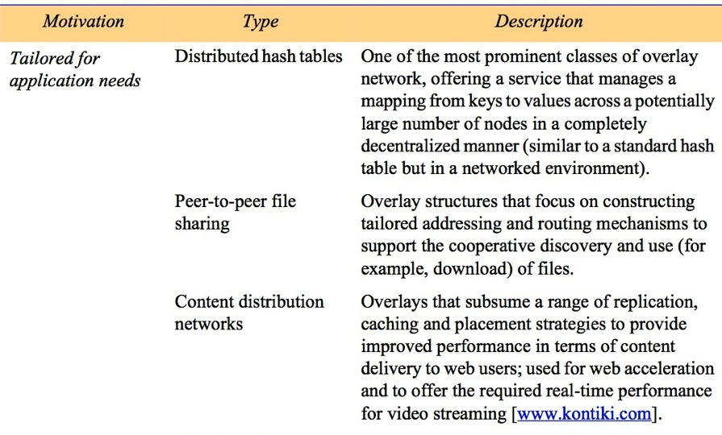
Figure 4.15
Types of overlay
table continues on the next slide
Instructor’s Guide for Coulouris, Dollimore, Kindberg and Blair, Distributed Systems: Concepts and Design Edn. 5
© Pearson Education 2012

Slide 19
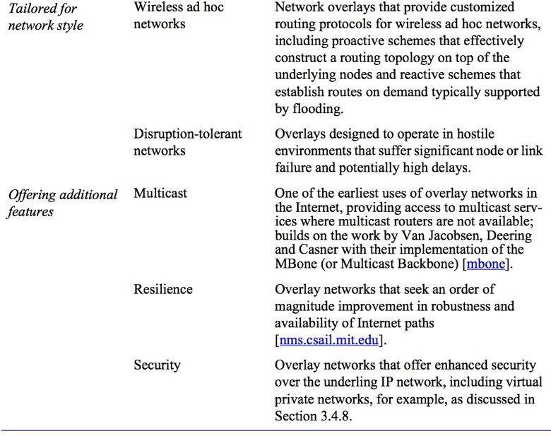
Figure 4.15 (continued)
Types of overlay
Instructor’s Guide for Coulouris, Dollimore, Kindberg and Blair, Distributed Systems: Concepts and Design Edn. 5
© Pearson Education 2012

Slide 20
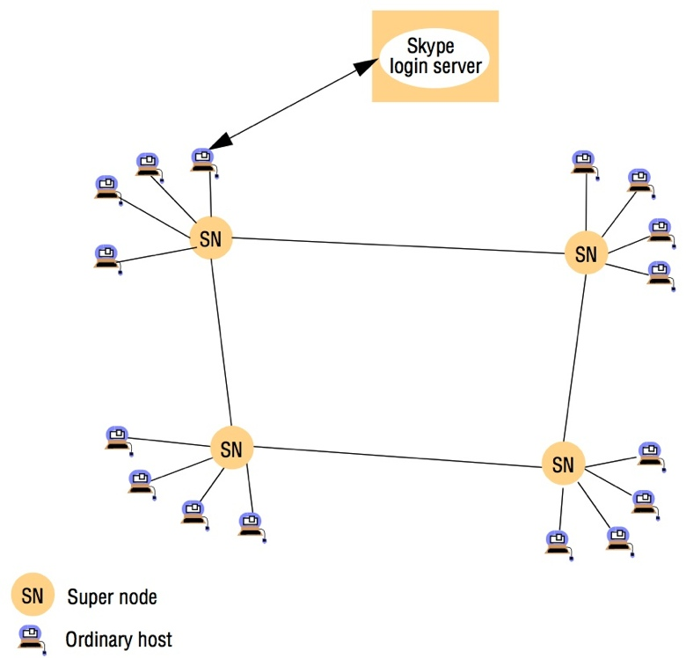
Figure 4.16
Skype overlay architecture
Instructor’s Guide for Coulouris, Dollimore, Kindberg and Blair, Distributed Systems: Concepts and Design Edn. 5
© Pearson Education 2012

Slide 21
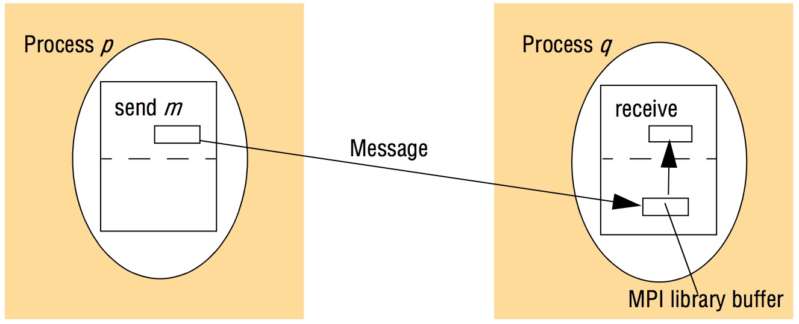
Figure 4.17
An overview of point-to-point communication in MPI
Instructor’s Guide for Coulouris, Dollimore, Kindberg and Blair, Distributed Systems: Concepts and Design Edn. 5
© Pearson Education 2012

Slide 22
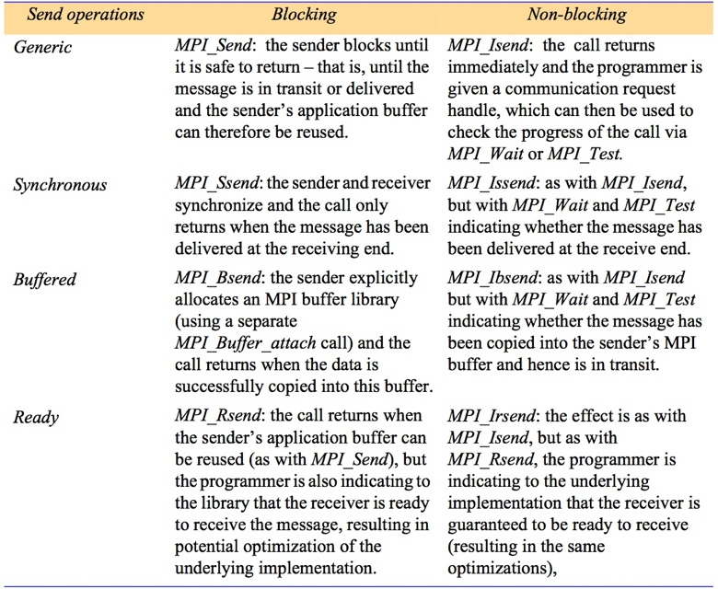
Figure 4.18
Selected send operations in MPI
Instructor’s Guide for Coulouris, Dollimore, Kindberg and Blair, Distributed Systems: Concepts and Design Edn. 5
© Pearson Education 2012

